Slide 1




React Form!
Quickly and easily building awesome forms
Dan Toft
Microsoft 365 Consultant Denmark
Blog.Dan-Toft.dk
@Tanddant

Slide 2
The problem?
View formatting is hard - and not that end user friendly
Worry free data collection
“That can’t be done” – my boss

Slide 3
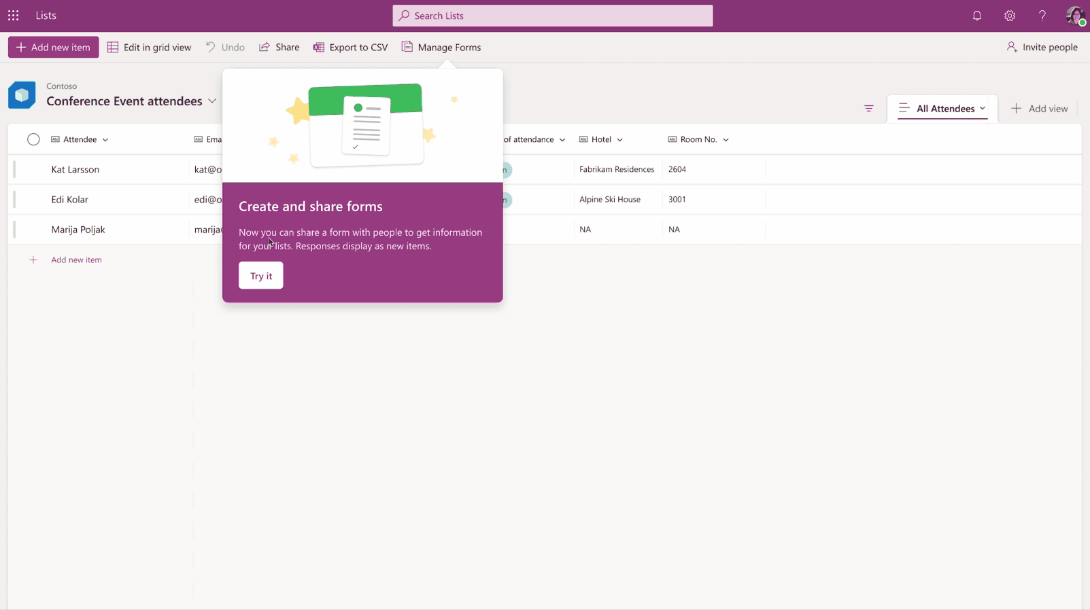
Microsofts take (October 2023)
Notes:
http://aka.ms/M365/May2/Lists

Slide 4

Demo
Demo
Notes:
Fill out initial form
Design a new form
Talk over responses, democh

Slide 5
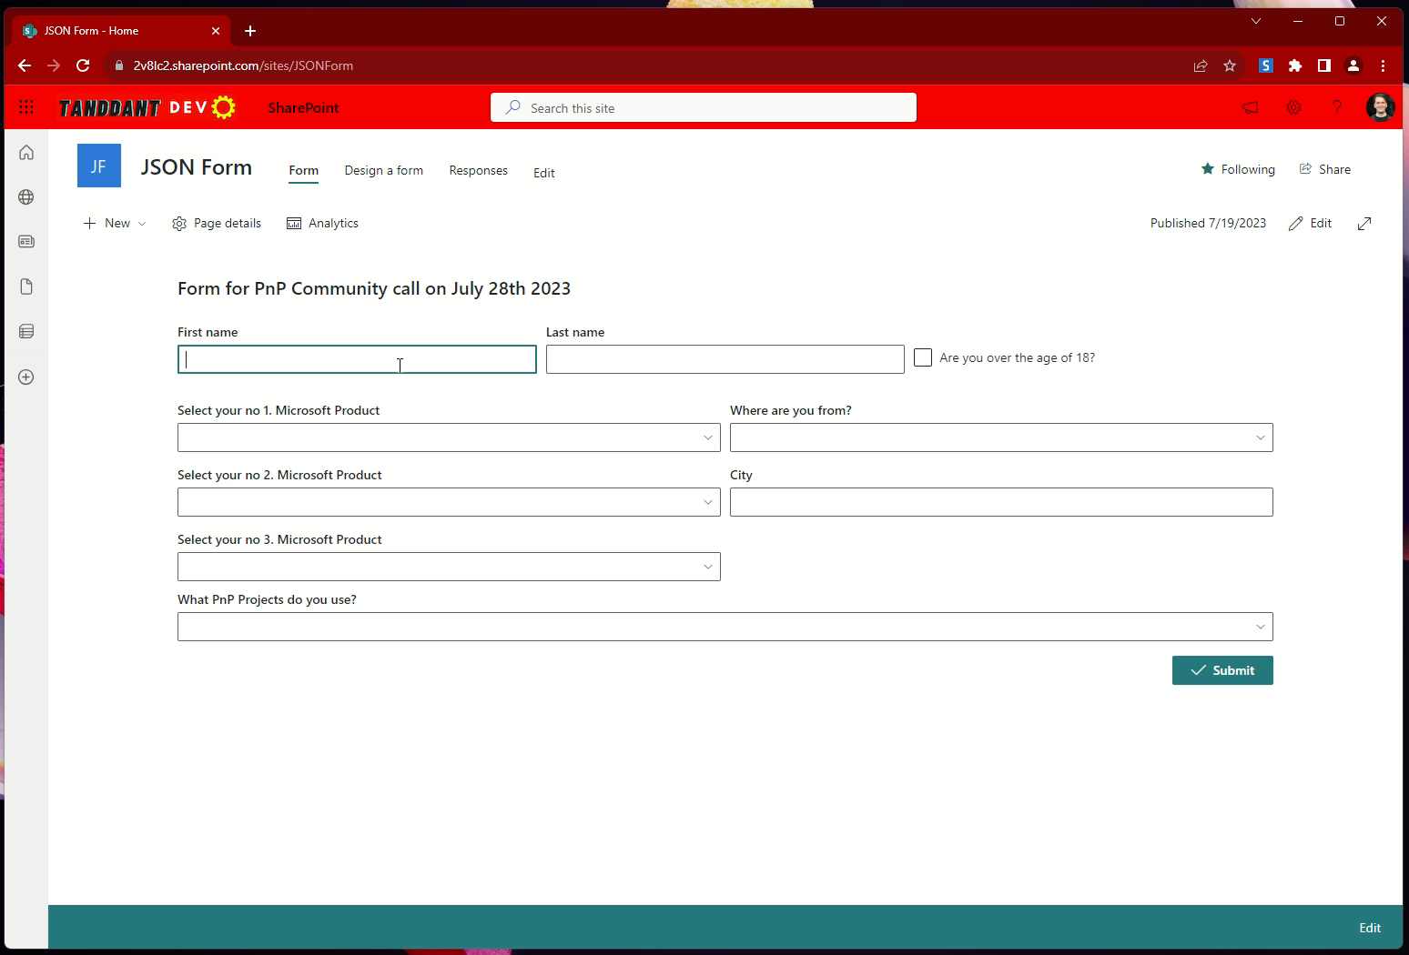

Slide 6
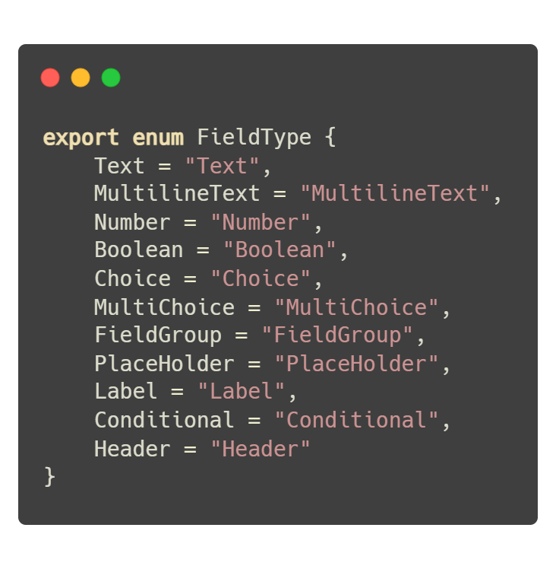
Fieldtypes

Slide 7
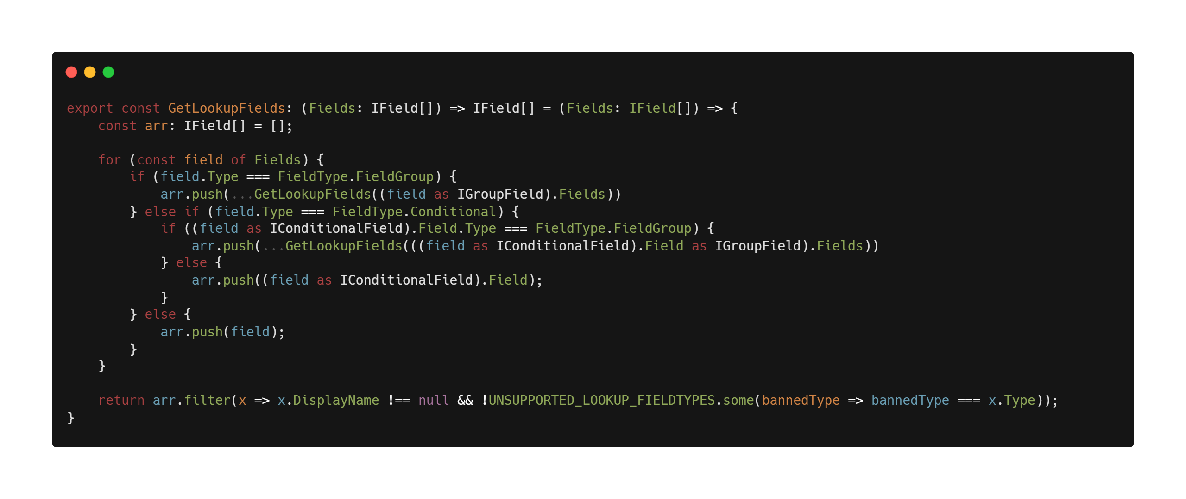

Slide 8
Cool ideas
Create and save to SharePoint list, setup fileds, not just file
Lookup/User fields (Makayla Harder @makaylacmac2)
Drag and drop move of fields
Required fields

Slide 9
Thank you!
Sample: https://github.com/pnp/sp-dev-fx-webparts/tree/main/samples/react-json-form
Slides: https://github.com/tanddant/slides
Dan Toft
Microsoft 365 Consultant Denmark
Blog.Dan-Toft.dk
@Tanddant

